Slide 1

Retail Outlet Visit
BBA 2nd SEM (2022-23)
Submitted By-
Shankh Bansal
AU22C1013
Submitted To-
Dr. Ankur Rastogi

Slide 2
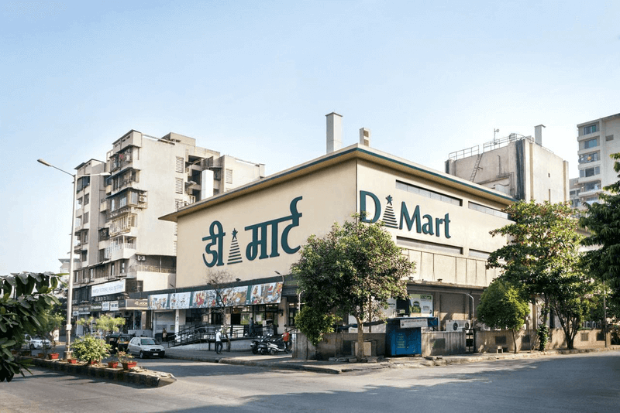
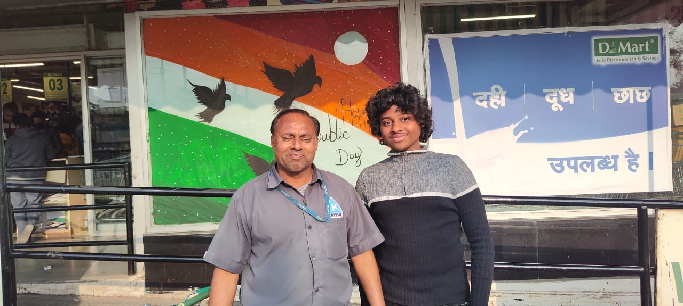
D MART
DMart is a one-stop supermarket chain that aims to offer customers a wide range of basic home and personal products under one roof. Each DMart store stocks home utility products - including food, toiletries, beauty products, garments, kitchenware, bed and bath linen, home appliances and more - available at competitive prices that our customers appreciate. Our core objective is to offer customers good products at great value.

Slide 3
Target customer/ Dealers
Zero frills.
Bulk purchases.
Direct to customer.
Low operating cost.
Less spending on advertisement.
Ownership to retail space.
Limited product category.

Slide 4
Location
Advantages
Disadvantages
The mart buys in bulk direct from the manufacturer, therefore they are able to sell customers at very competitive price.
Customers benefits from quick services and can take their own time to select the supermarket is run efficiently.
Open displayed encourages shop lifting.
No personal services to consumers.
Far away from the city.
Time consuming.

Slide 5
Product offered by the dealers
DMart follows Business to Consumer [B2C] model where goods are directly procured from manufacturer and sold to the customer via their retail outlet.
DMart pays within 15 days to all it’s vendors which is quick as compared to other retail chains.
DMart has kept emphasis on selling only FMCG products [both food & nonfood], general household merchandise & apparel.
DMart started and is still headquartered in Mumbai, has over the years expanded it’s business all over India.
The interiors of every DMart store is kept very basic and minimal in order to keep maintenance cost low.
This is a term used for how fast does a retail store sells its inventory. It is a term used for the time the goods are stocked in the store till these are sold off.
Where big retailers have opted for big budget advertising across all media channels, DMart has kept it very basic and low profile.
The major cost that any retailer has is often employee cost.
DMart Ready : This is DMart’s online service where one can order online and collect from the nearest DMart pick up point.

Slide 6
Environment of the dealer premises
The Indian retail industry is emerging as one of the most dynamic and growing industries due to the market size and economic power. DMart is increasingly profitable retail supermarket chain in India that aims to offer customers a wide range of basic home and personal products under one roof with an objective to offer good products at great prices. Customers prefer DMart for better value for money and masses of discounts than their competitors. Their target customers are middle-income groups and families who are aspiring to meet most regular consumer needs. DMart is termed as Indian Walmart and this accomplishment is largely due to their business philosophy, long-term vision, pricing strategy, cautious focus, regimented model, ACT formula, innovative planning and product categories. DMart’s financial and market success is due to three major pillars, they are customers, vendors and employees. The data is collected from customers and employees using the questionnaire and interviews to build up qualitative inferences. While the financial and market reports are collected from authenticated sources. This case also discusses the qualities, lessons and reasons for the success of DMart in India.

Slide 7
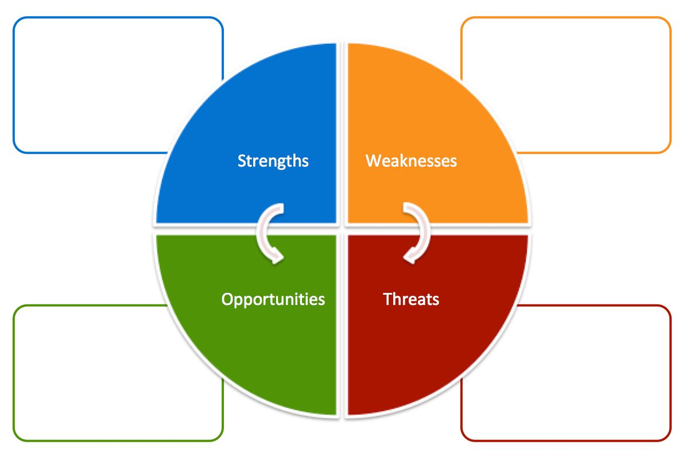
Scope of further development
Digital platform
Discount policy
Family experience
National presence
Distribution channels
Slow growth
Rented assets
No frills approach
Focus on certain places
Growth potential
Quality of services
Personalized services
Improving technology
Developing economics
Online start up
Unorganized retail
Government policies
Online competition
Low barriers to Entry

